Slide 1
Survey Of Papers
Adil Sarsenov

Slide 2
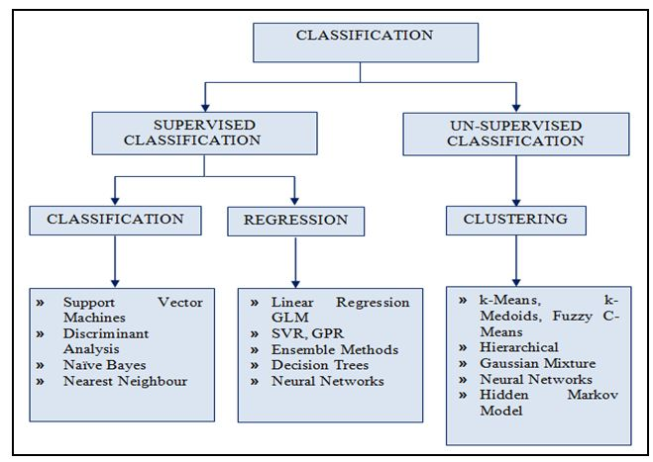
Sentimental Analysis and Text Processing

Slide 3
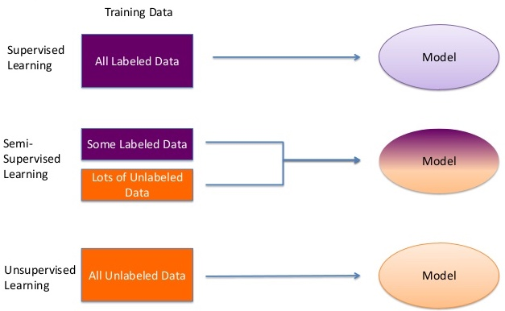
Types of Learning

Slide 4
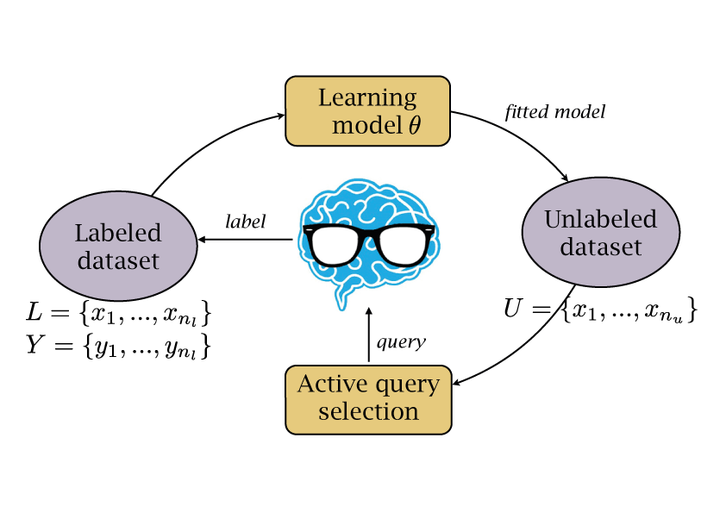
Active Learning for Text Classification
Selection of useful instances to be labeled in order to achieve similar performance with few data

Slide 5
Sentiment Analysis: Subjectivity
Applies text-categorization techniques to just subjective portions of the document.
Accuracy 87% “A gentleman tries to protect his good name”

Slide 6
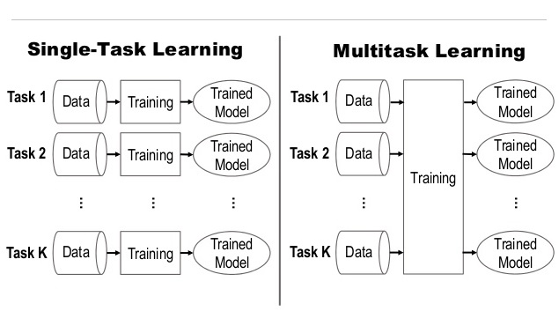
Multitask Learning

Slide 7
Conclusion
To sum up,
Unfortunately, classical algorithm does not work same for sentiment classification. Deep Learning approaches copes with this task much better.
This obviously provides evidence that sentiment classification is much more difficult and challenging than topic categorization

Slide 8
References:
[1] A. K. Jain, M. N. Murty, and P. J. Flynn, “Data Clustering: A Review”, Journal ACM Computing Surveys (CSUR) Surveys Homepage archive, vol 31 Issue 3, Sept. 1999 [2] Bo Pang, Lillian Lee, and Shivakumar Vaithyanathan, “Thumbs Up: Sentiment classification using Machine Learning Techniques”, Philadelphia, July 2002, pp. 79-86. [3] Ronan Collobert, Jason Weston, “A Unified Architecture for Natural Language Processing: Deep Neural Networks with Multitask Learning”, ICML '08 Proceedings of the 25th international conference on Machine learning, July 05 - 09, 2008 [4] Bo Pang, Lillian Lee, “A Sentimental Education: Sentiment Analysis Using Subjectivity Summarization based on Minimum cuts”, ACL '04 Proceedings of the 42nd Annual Meeting on Association for Computational Linguistics, July 21 – 26, 2004 [5] Simon Tong, Daphne Koller, “Support Vector Machine Active Learning with Applications to Text Classification”, The Journal of Machine Learning Research archive, January 11,2001

